Slide 1


Slide 2
Agenda
Introduction to Xamarin
Cross Platform UI with Xamarin.Forms
Connected Apps with Azure
Lunch – Courtesy of Sponsor
File -> New App Workshop

Slide 3
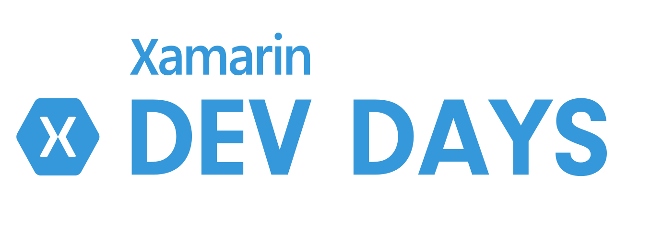

Slides, Demos, & Lab - Clone or Download:
http://github.com/xamarin/dev-days-labs

Slide 4
ARE YOU READY
to build Cross-Platform Apps?

